Slide 1

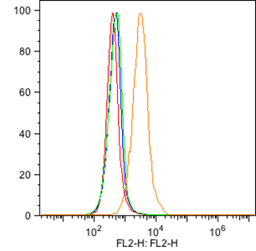
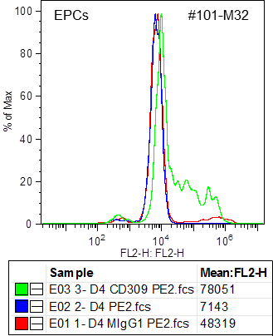

ReliaTech GmbH
Mouse anti-human VEGFR-2/KDR
(Cat #101-M32)
#101-M32
Fig. 1: FACS analysis of VEGFR-2/KDR expression in HUVE cells (left panel) and EPCs derived from PBMcs (right panel) [5μg/ml #101-M32; 5μg/ml PE goat anti-mouse IgG].
The experiment was performed by Trisha M. Westerhof, University of California, Irvine.
http://www.reliatech.de / orders@reliatech.de

